Slide 1
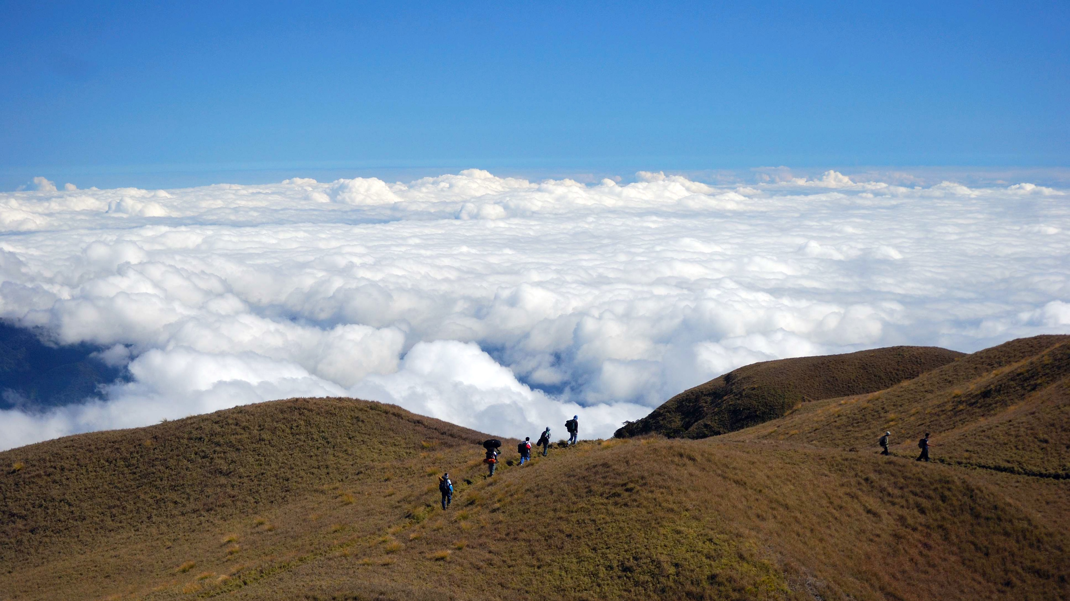

Mary Condolora, Roohi Kumar, Victor Fu, Dora Antal, David Kang,
Nick Peng, Ricardo

Slide 2
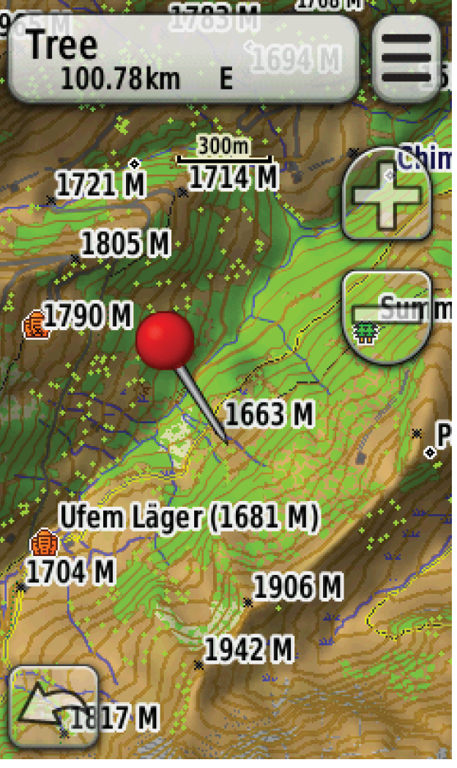
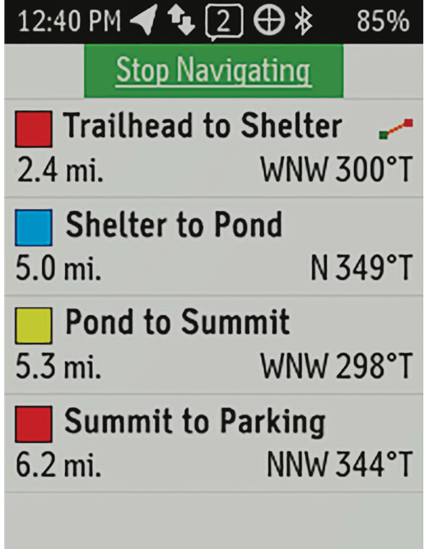
Current Status:
Notes:
Dogtag requires no battery

Slide 3
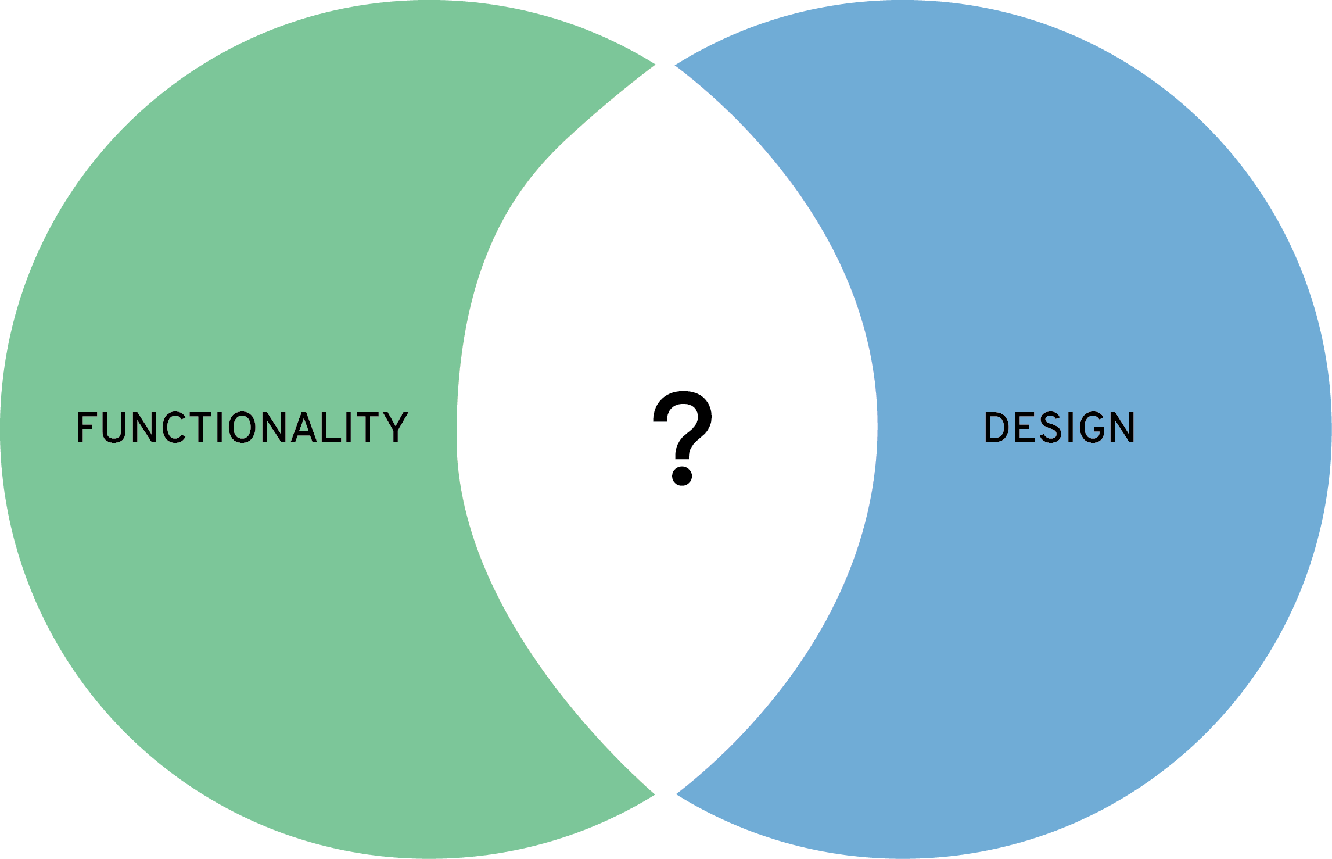
Needs and Opportunities
Need for a durable recreational device that adequately combines navigation and emergency features
Need for a versatile, interactive product that is easy to use for both amateurs and professionals without compromising functionality
Opportunity to build on the social aspect of everyday life
Opportunity to further extend our brand into the health and fitness category

Slide 4
Why revamp?
Device is extremely outdated
Safety features are concentrated to one person in a group
Features are very limited
SOS is only for situations of critical danger and need
Technology is overly complex and non-intuitive

Slide 5
It’s time to reimagine the inReach

Slide 6
Two Major Engineering Limitations
We want to provide everyone in a group with safety features
We want the system to be robust enough to handle any length of trip

Slide 7


Target Market
Families or groups of people who take part in recreational activities together (i.e. biking, hiking, etc.) ranging anywhere from 7 to 70 years of age.

Slide 8
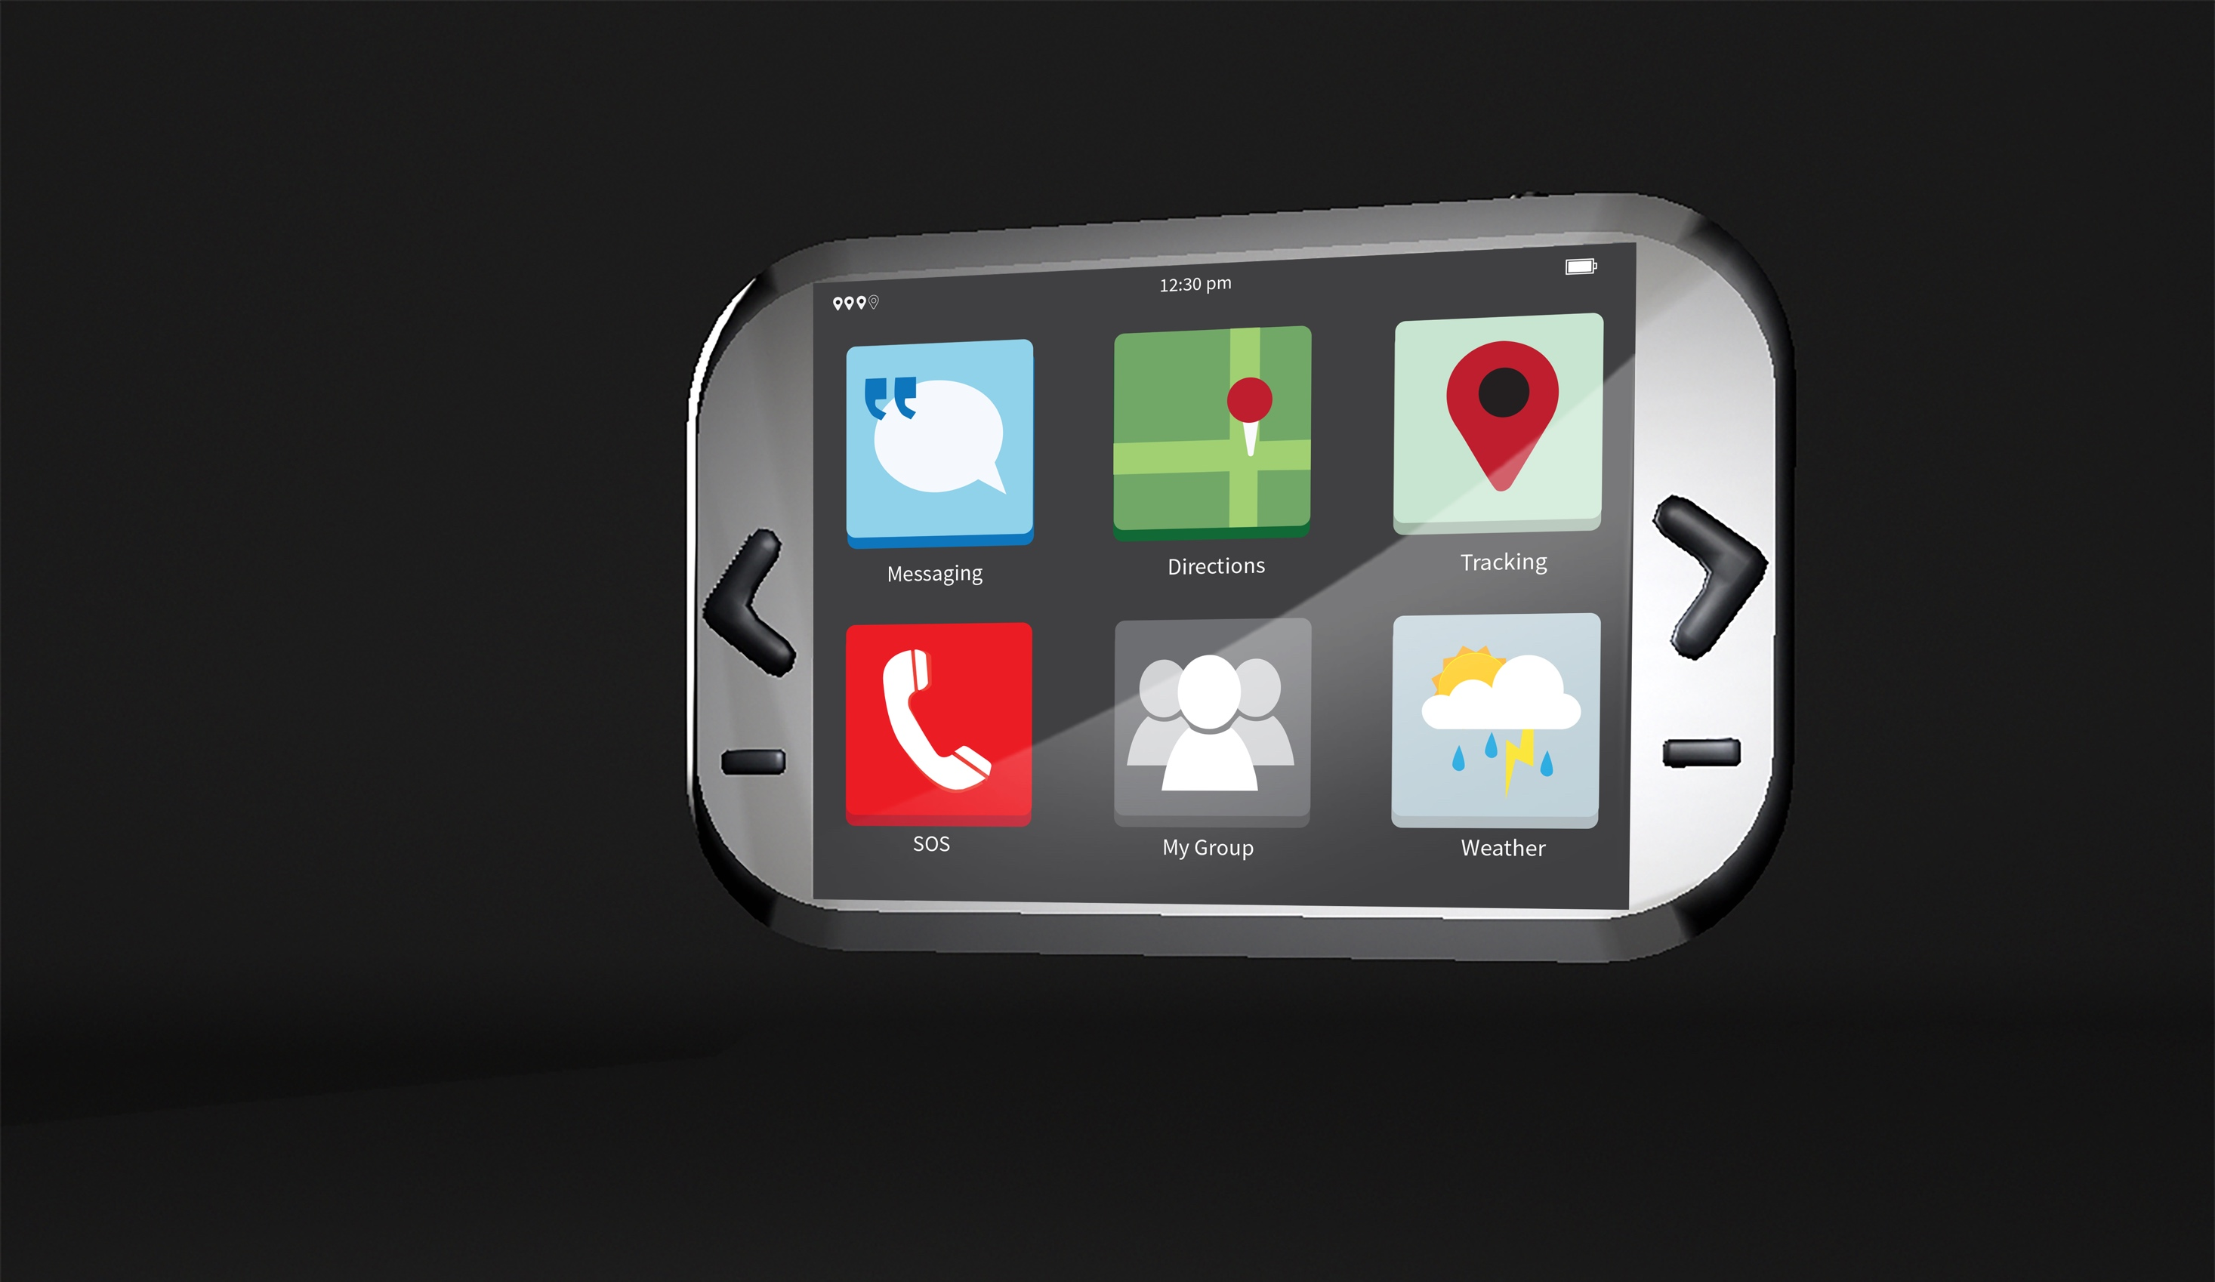

Slide 9
Design
Power
Right and Left control buttons
OK button
Back button

Slide 10
Engineering
GPS Navigation and Tracking
Send and Receive Messages
Emergency SOS
Altimeter
Temperature
Compass
Fall Detection
Solar Power Recharging

Slide 11
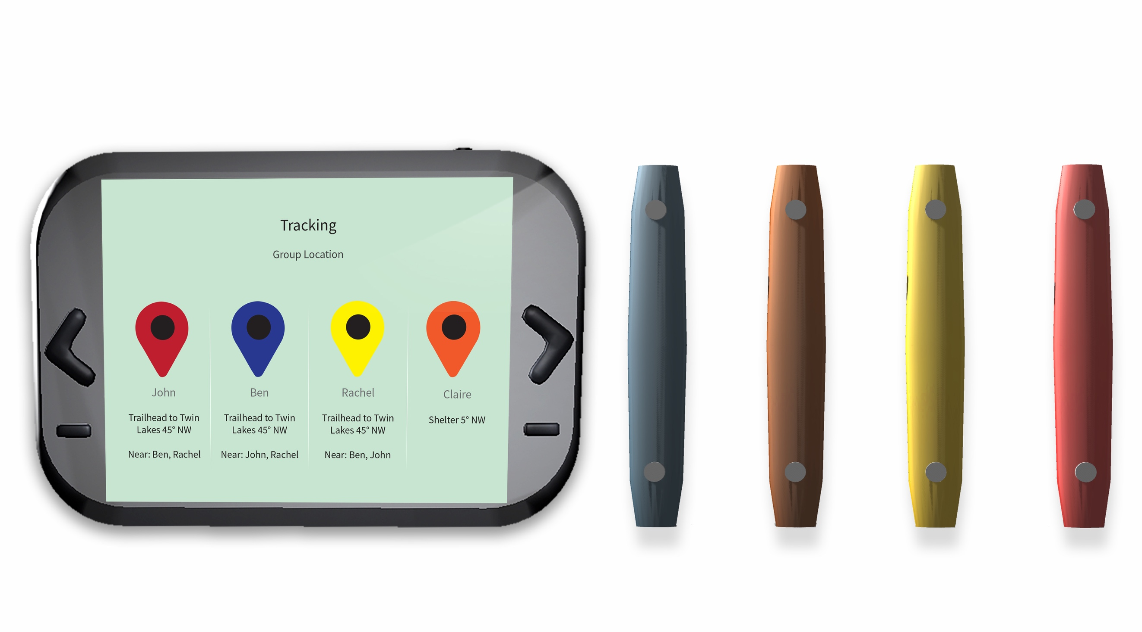
Dogtag Tracking

Slide 12


Slide 13
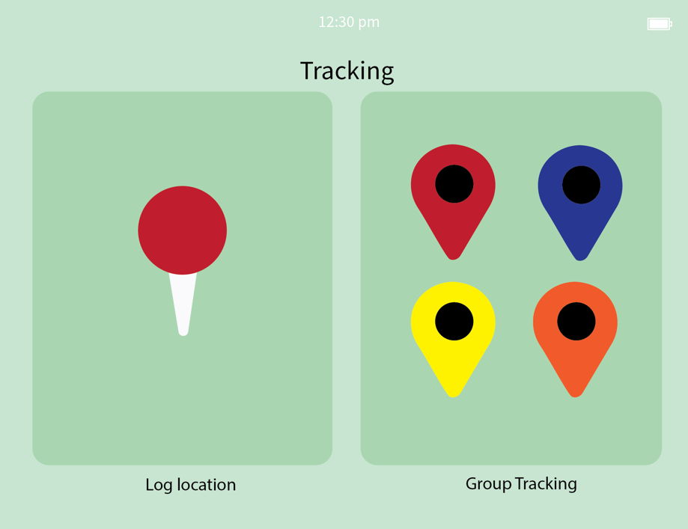
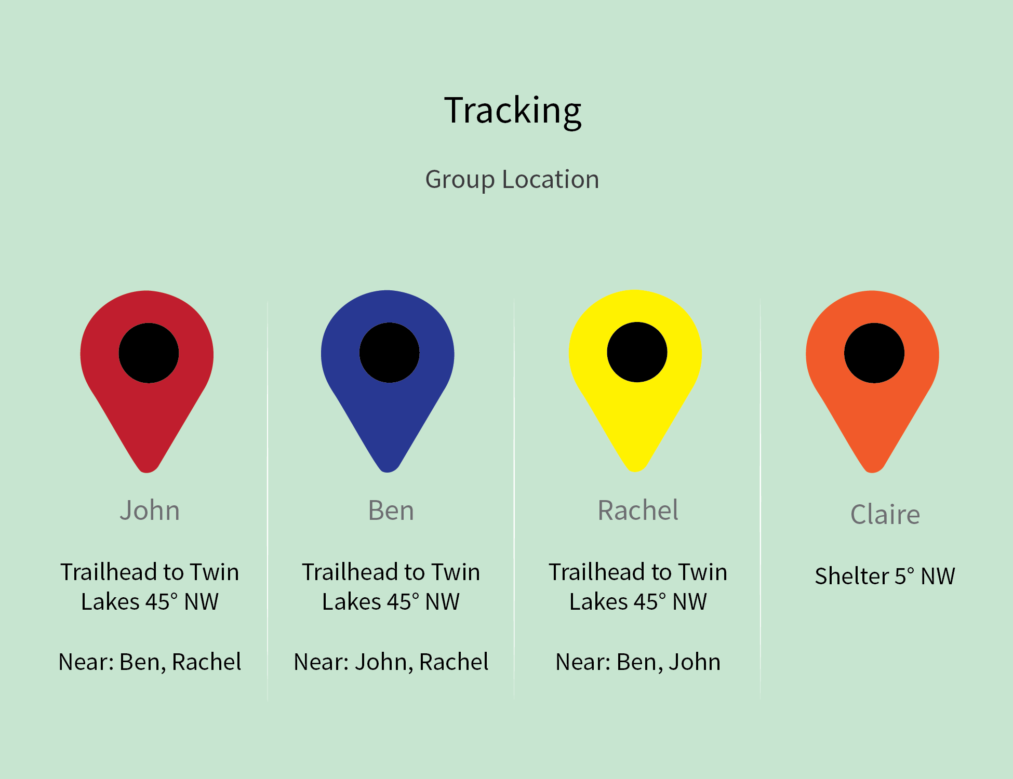
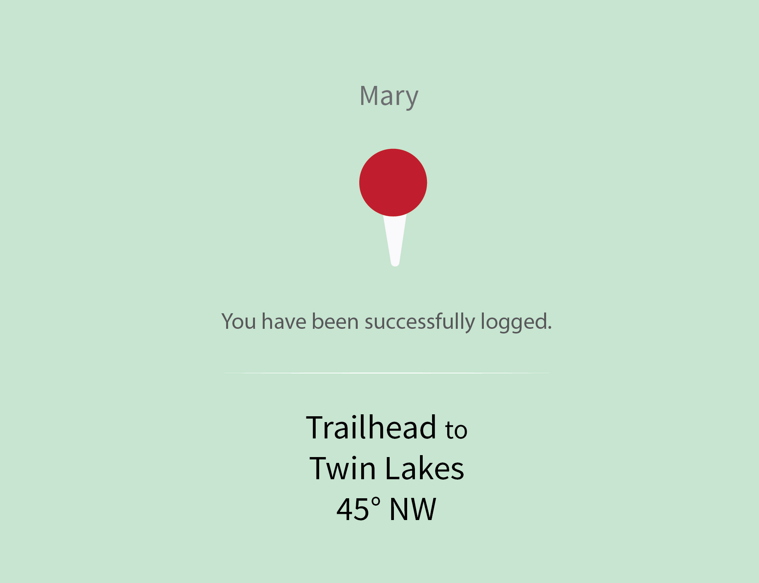
UI tracking

Slide 14
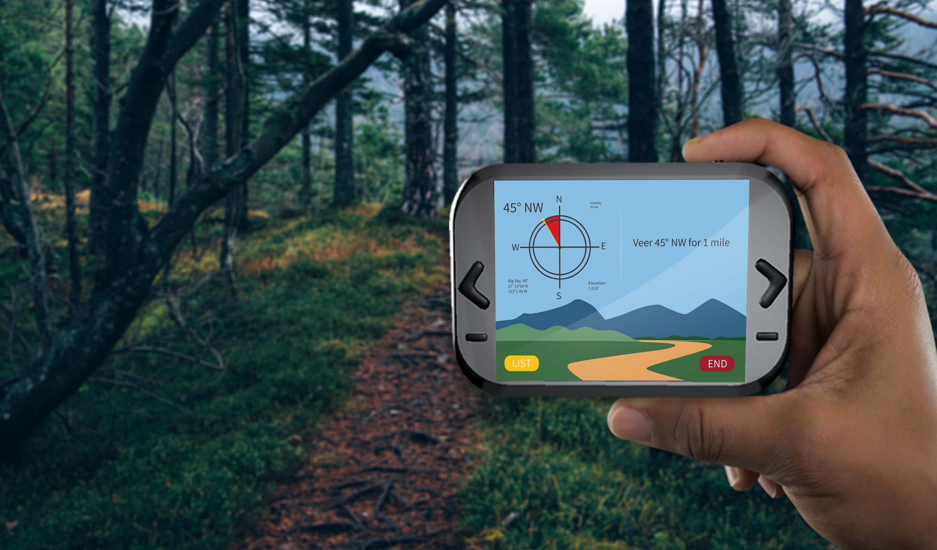
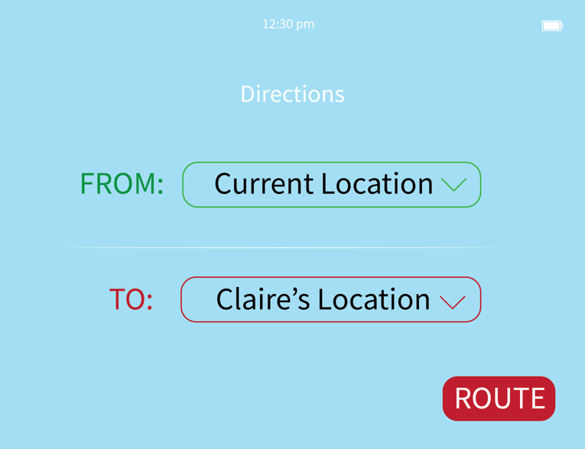
UI directions

Slide 15
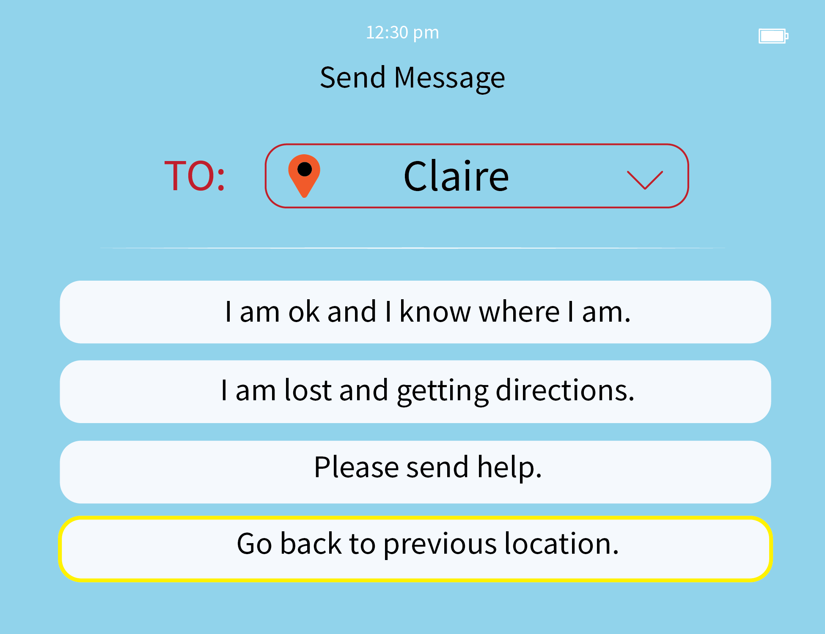
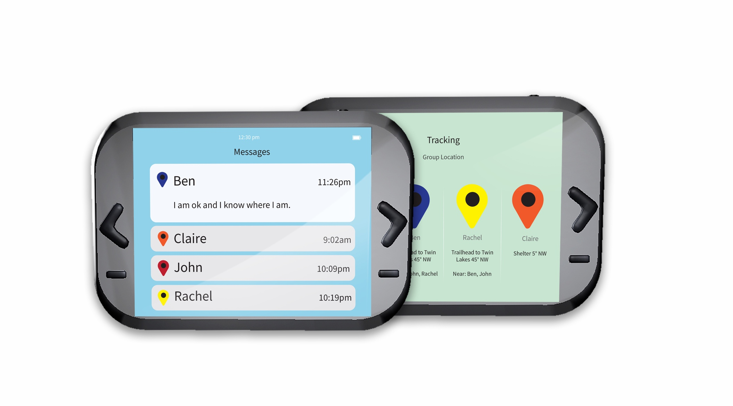
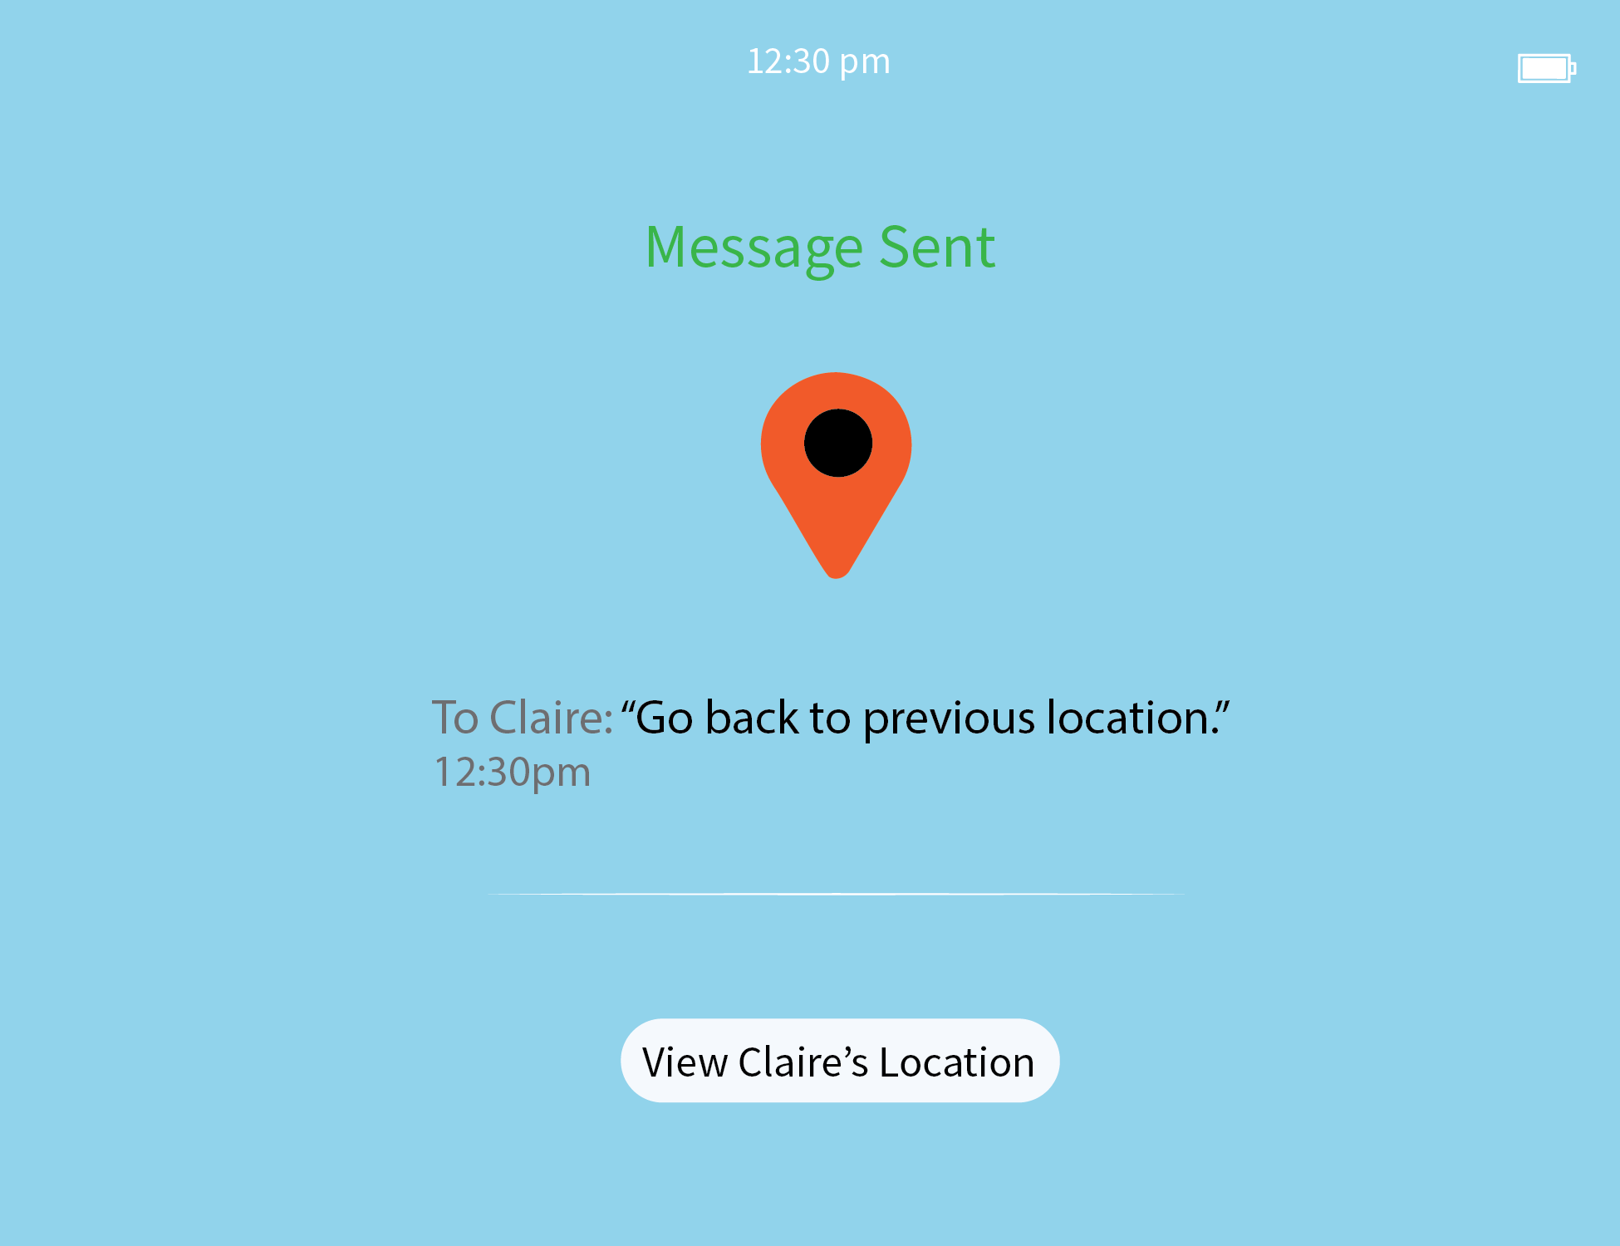
UI messages

Slide 16
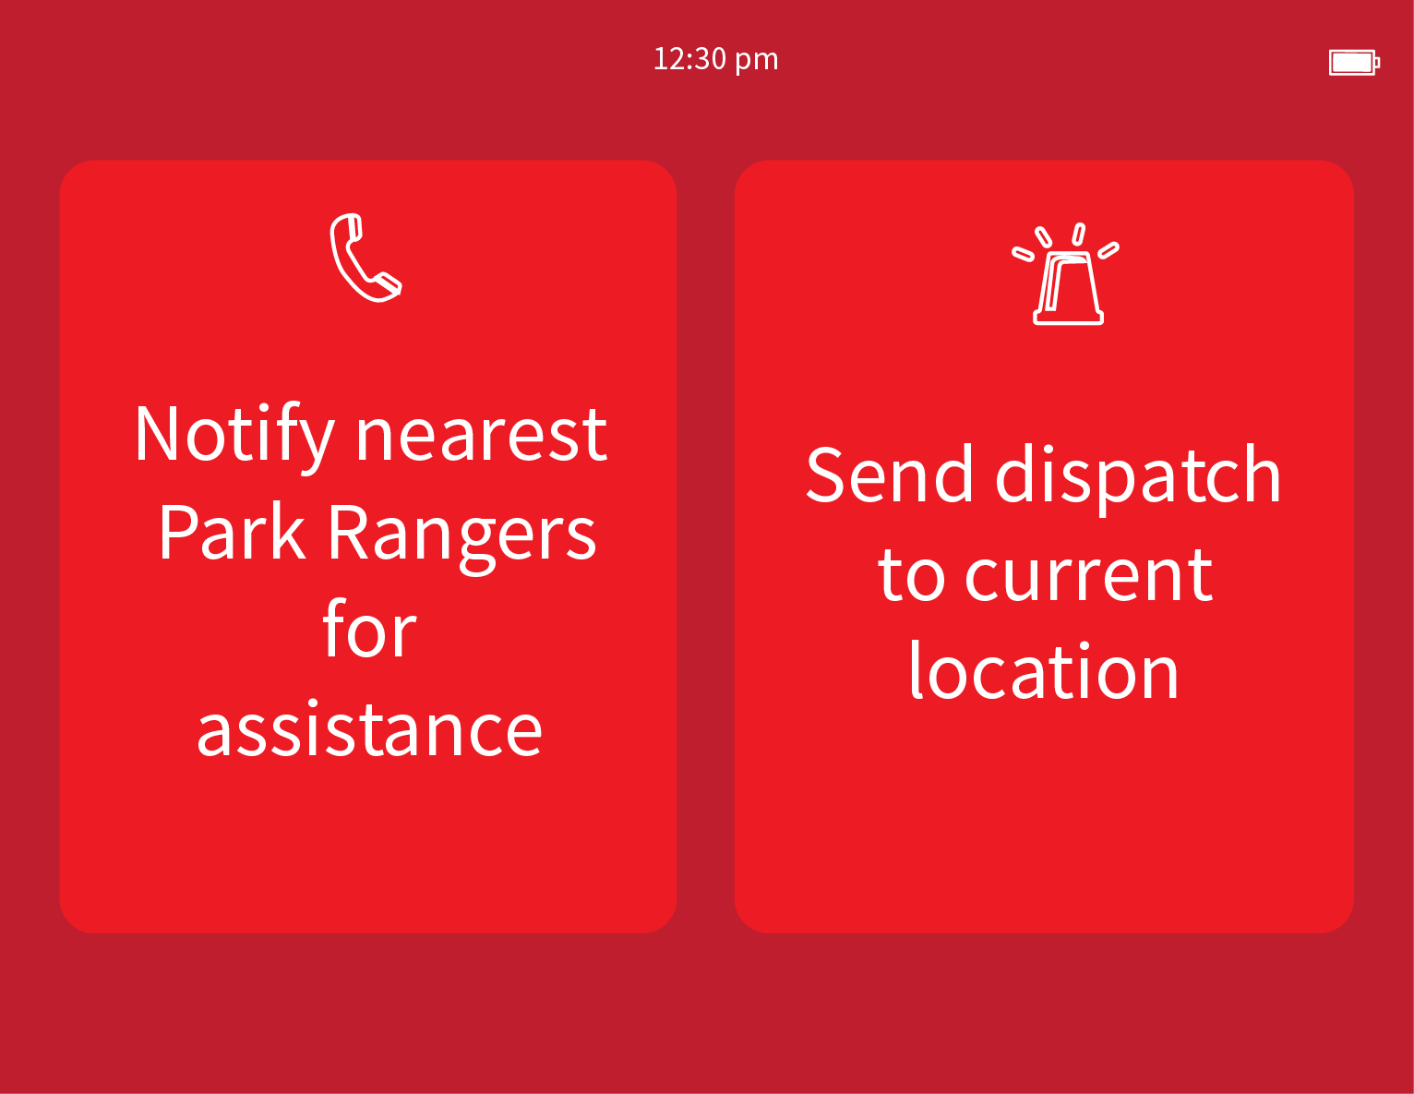
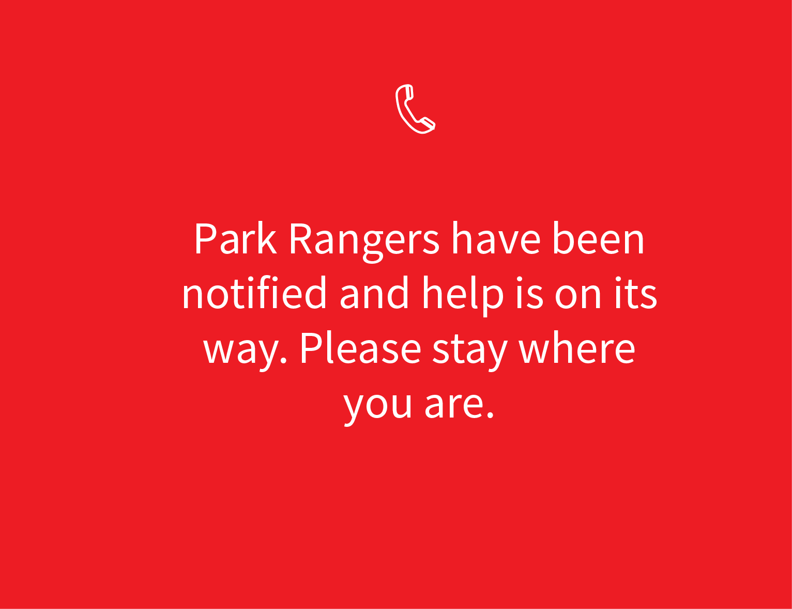
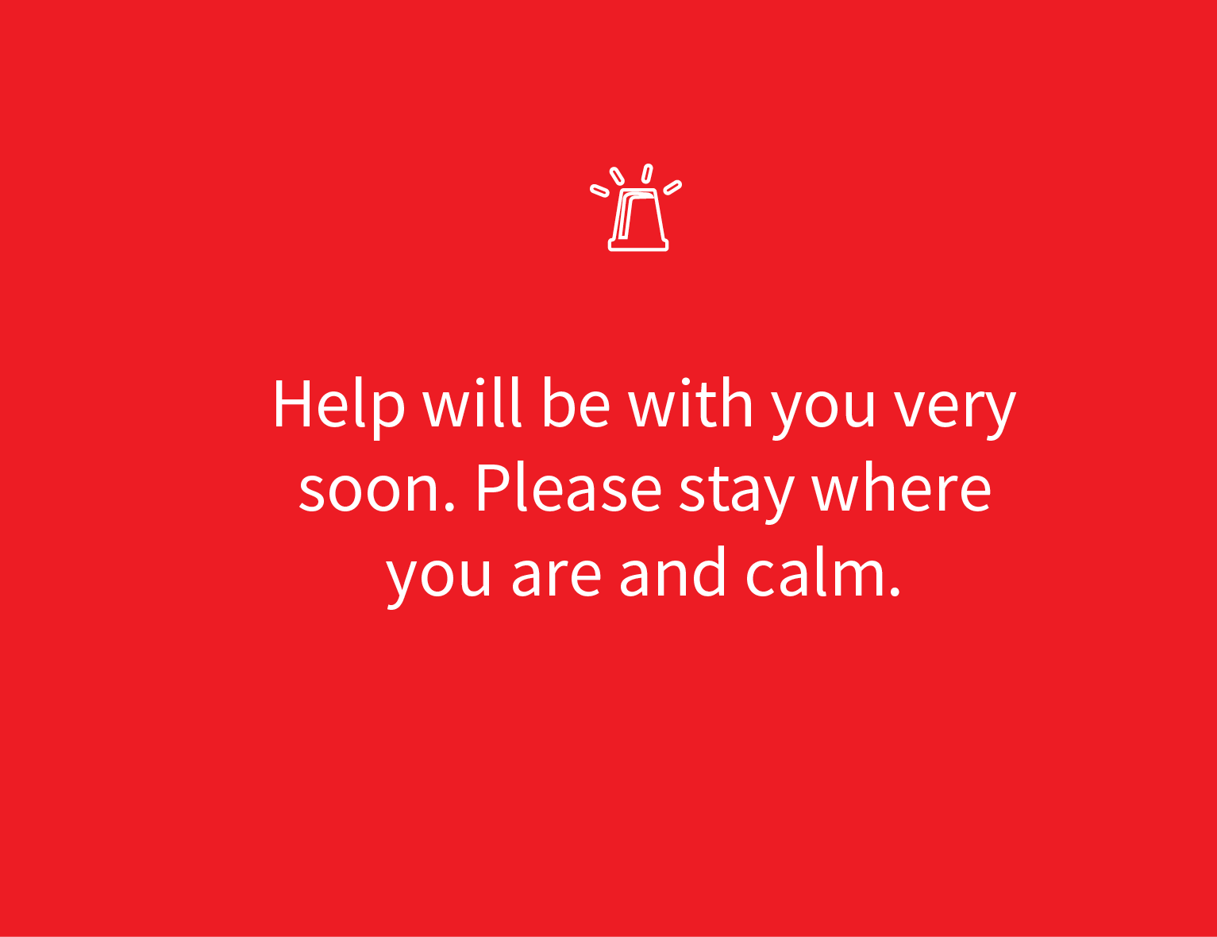
UI SOS

Slide 17

Consumer Benefits
100% of consumers feel safer and more connected
80% of consumers feel more worry-free
70% of consumers feel more in control
70% of consumers feel more efficient

Slide 18


How Should SignPost be Positioned?
vs
“SignPost is the only safety and navigation device that allows friends and families to stay connected during outdoor recreational adventures.”
“SignPost is the only connective and interactive navigation device that allows adventure-seeking individuals to travel to any corner of the Earth without risking their safety.”

Slide 19


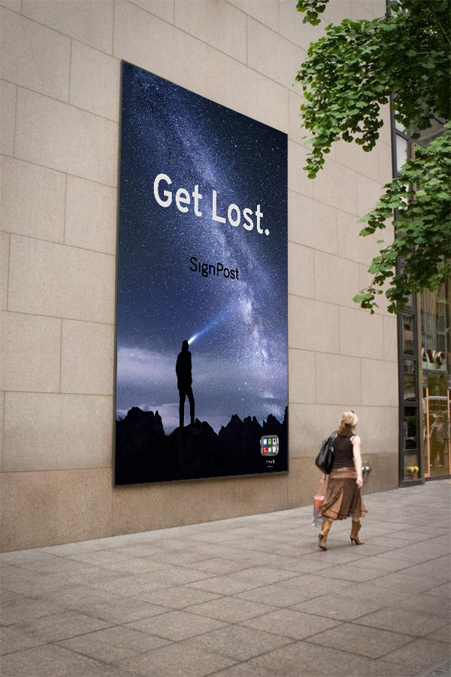
“SignPost is the only safety and navigation device that allows friends and families to stay connected during outdoor recreational adventures.”

Slide 20
